Slide 1
Exploiting Retrieval Latency Side-Channels in RAG Systems

Slide 2
Objective: Timing Side-Channel in RAG
Main Goal: Infer the presence, frequency, and semantic distribution of private terms within a RAG system.
The Side-Channel Loop:
Inject: Send contextually crafted prompts to the LLM.
Measure: Record the microsecond latency of the retrieval phase.
Analyze: Map the timing deviations against statistical thresholds.
Infer: Reconstruct the hidden semantic density of the database.
Attack Vector: Exploit query latency variances in Vector Databases (ChromaDB) during structural graph traversals.
Threat Model: Zero-knowledge attacker. No direct DB access or metadata extraction, relying purely on measuring response times.

Slide 3



Experimental Setup: Models & Dataset
Corpus & DB
Embeddings
LLMs Tested
Corpus: emozilla/pg19 dataset (Project Gutenberg Books). Processed into fixed 1000-character chunks.
Model: all-MiniLM-L6-v
Maps textual chunks into a 384-dimensional dense vector space optimized for semantic similarity.
Clusters high-frequency terms tightly, creating the physical density variations exploited during the attack.
Large Model: Qwen-2.5-7B-Instruct. Large production model. High inference time acts as noise, masking database latency.
Scale: ~3 million tokens
Tiny Model: SmolLM2-135M-Instruct. Tiny constrained model. Minimal generation time successfully isolates and exposes pure retrieval delays
Database: ChromaDB utilizing default HNSW (Hierarchical Navigable Small World) algorithm.

Slide 4
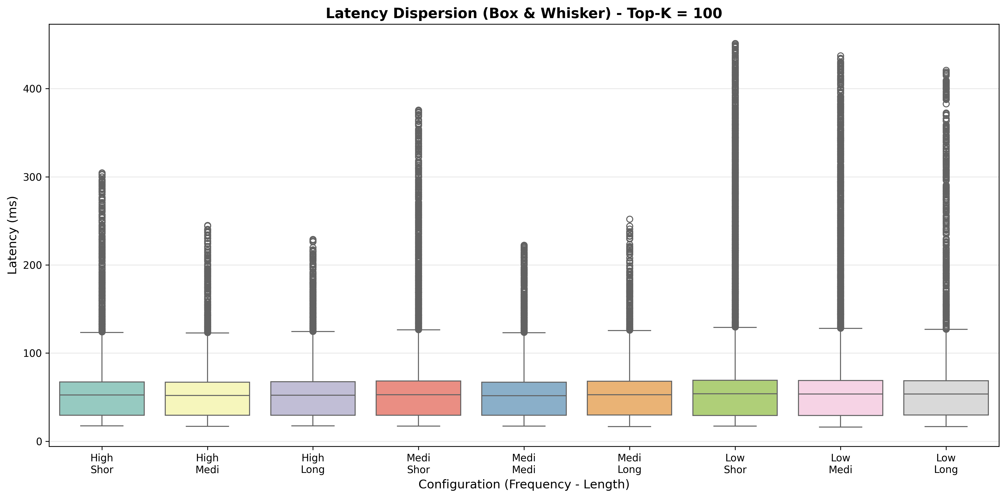
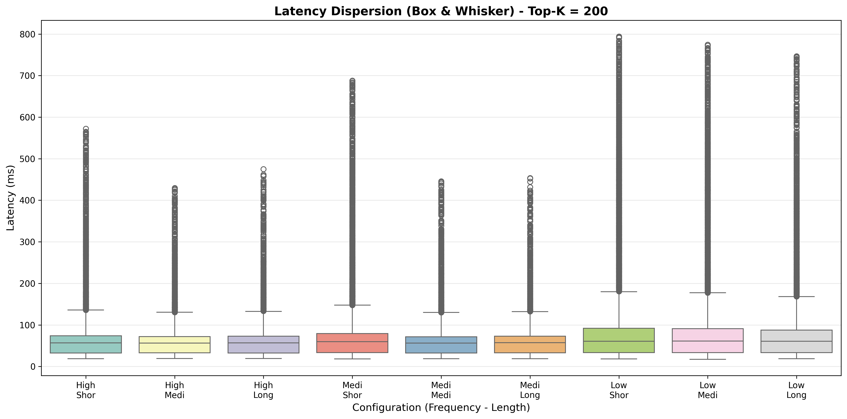
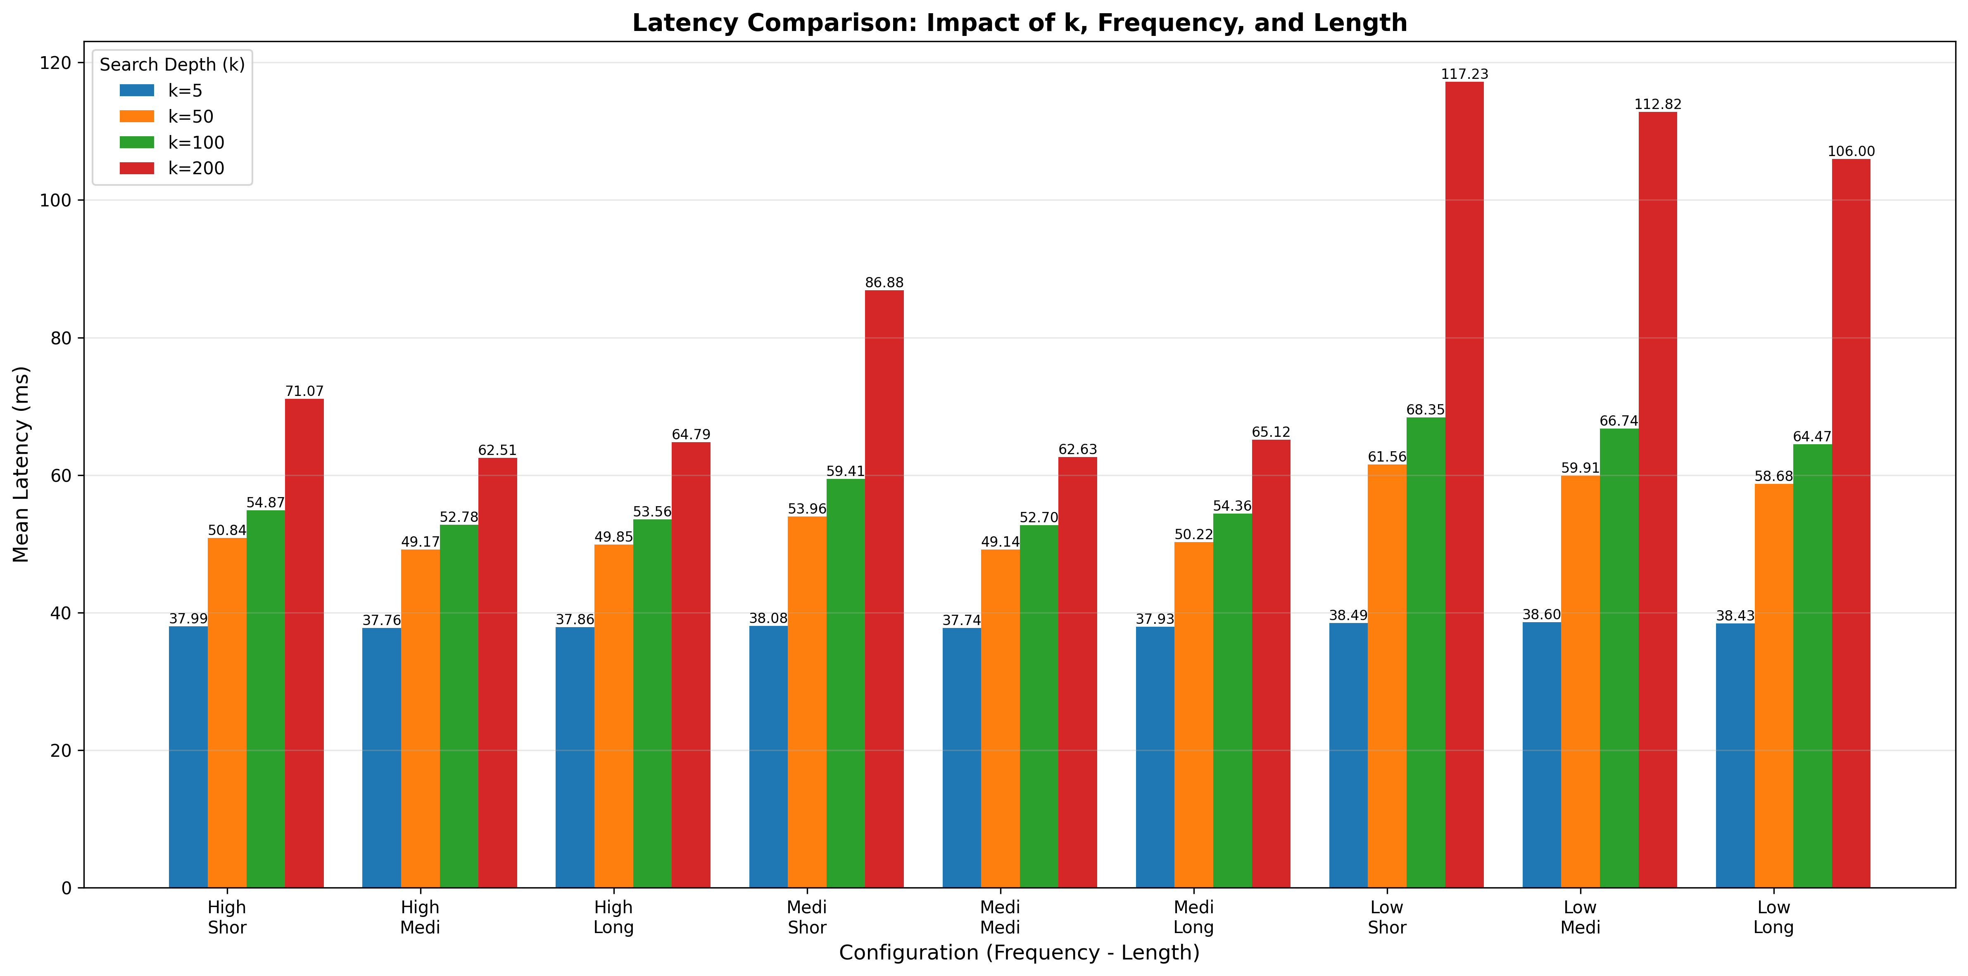
Baseline Results: Direct Database Queries
With higher values of K, the latency gap between high/medium and low-frequency terms significantly amplifies. This timing variation is exposed to a greater extent with shorter queries, although we also see it in the long ones, just somewhat less.

Slide 5
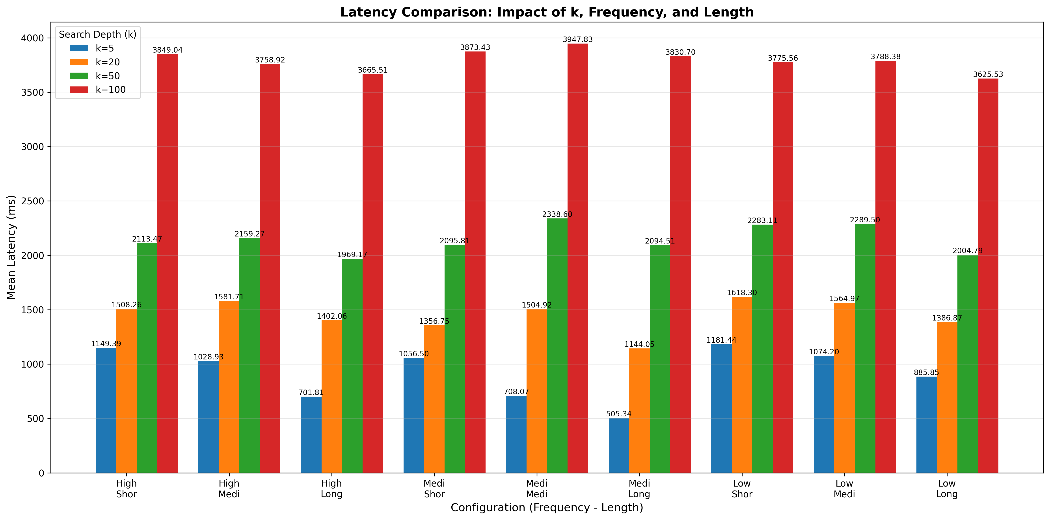
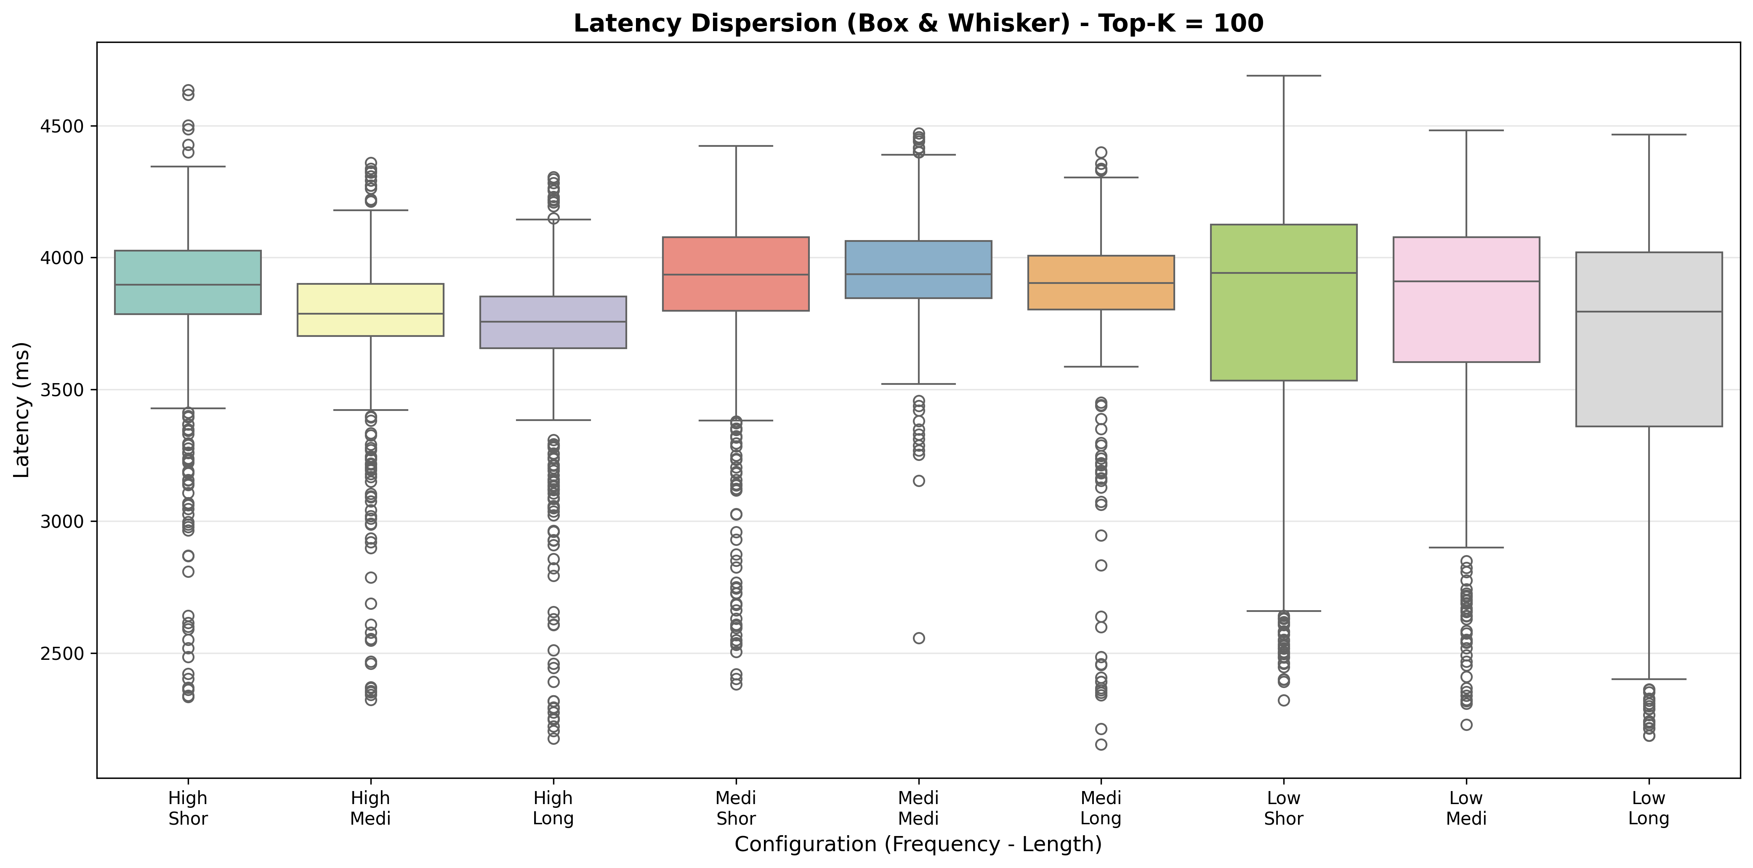
Large Language Model: Qwen-2.5-7B
The massive computational overhead of large models introduces excessive noise, making the underlying database latency differences practically indistinguishable and unmeasurable.

Slide 6
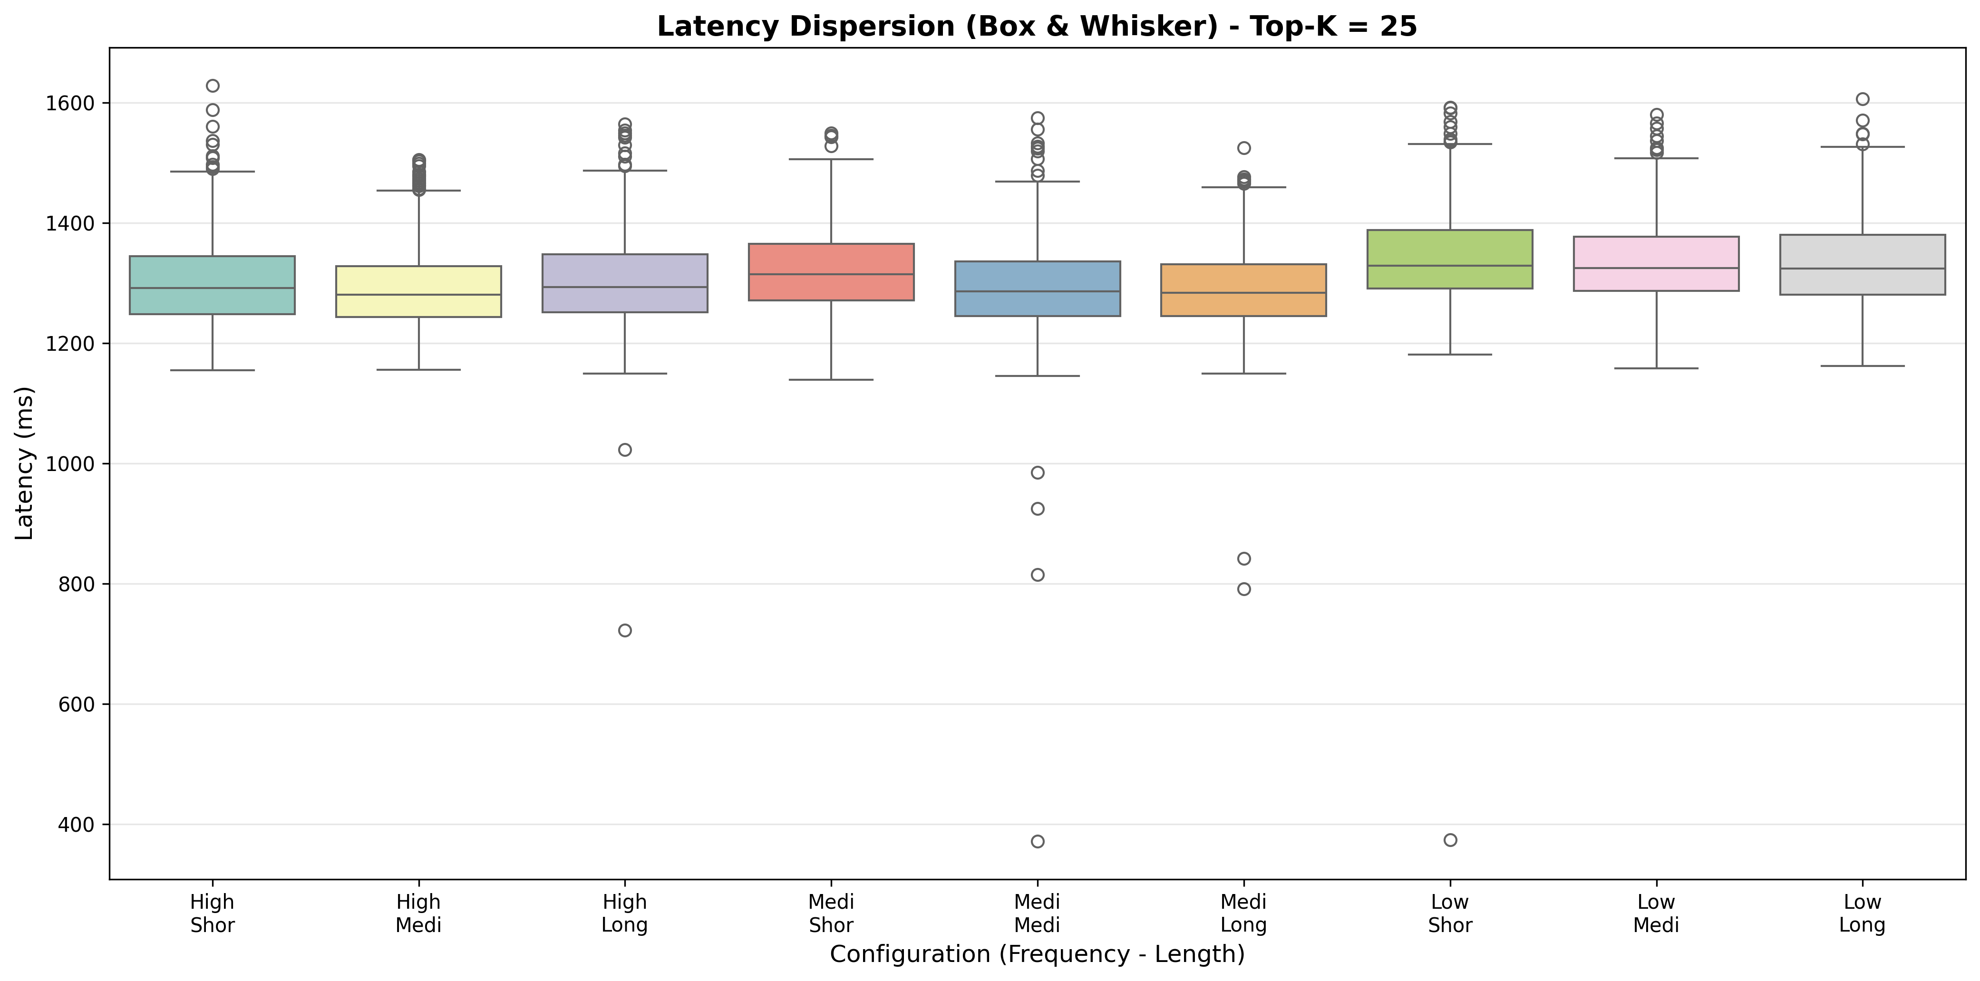
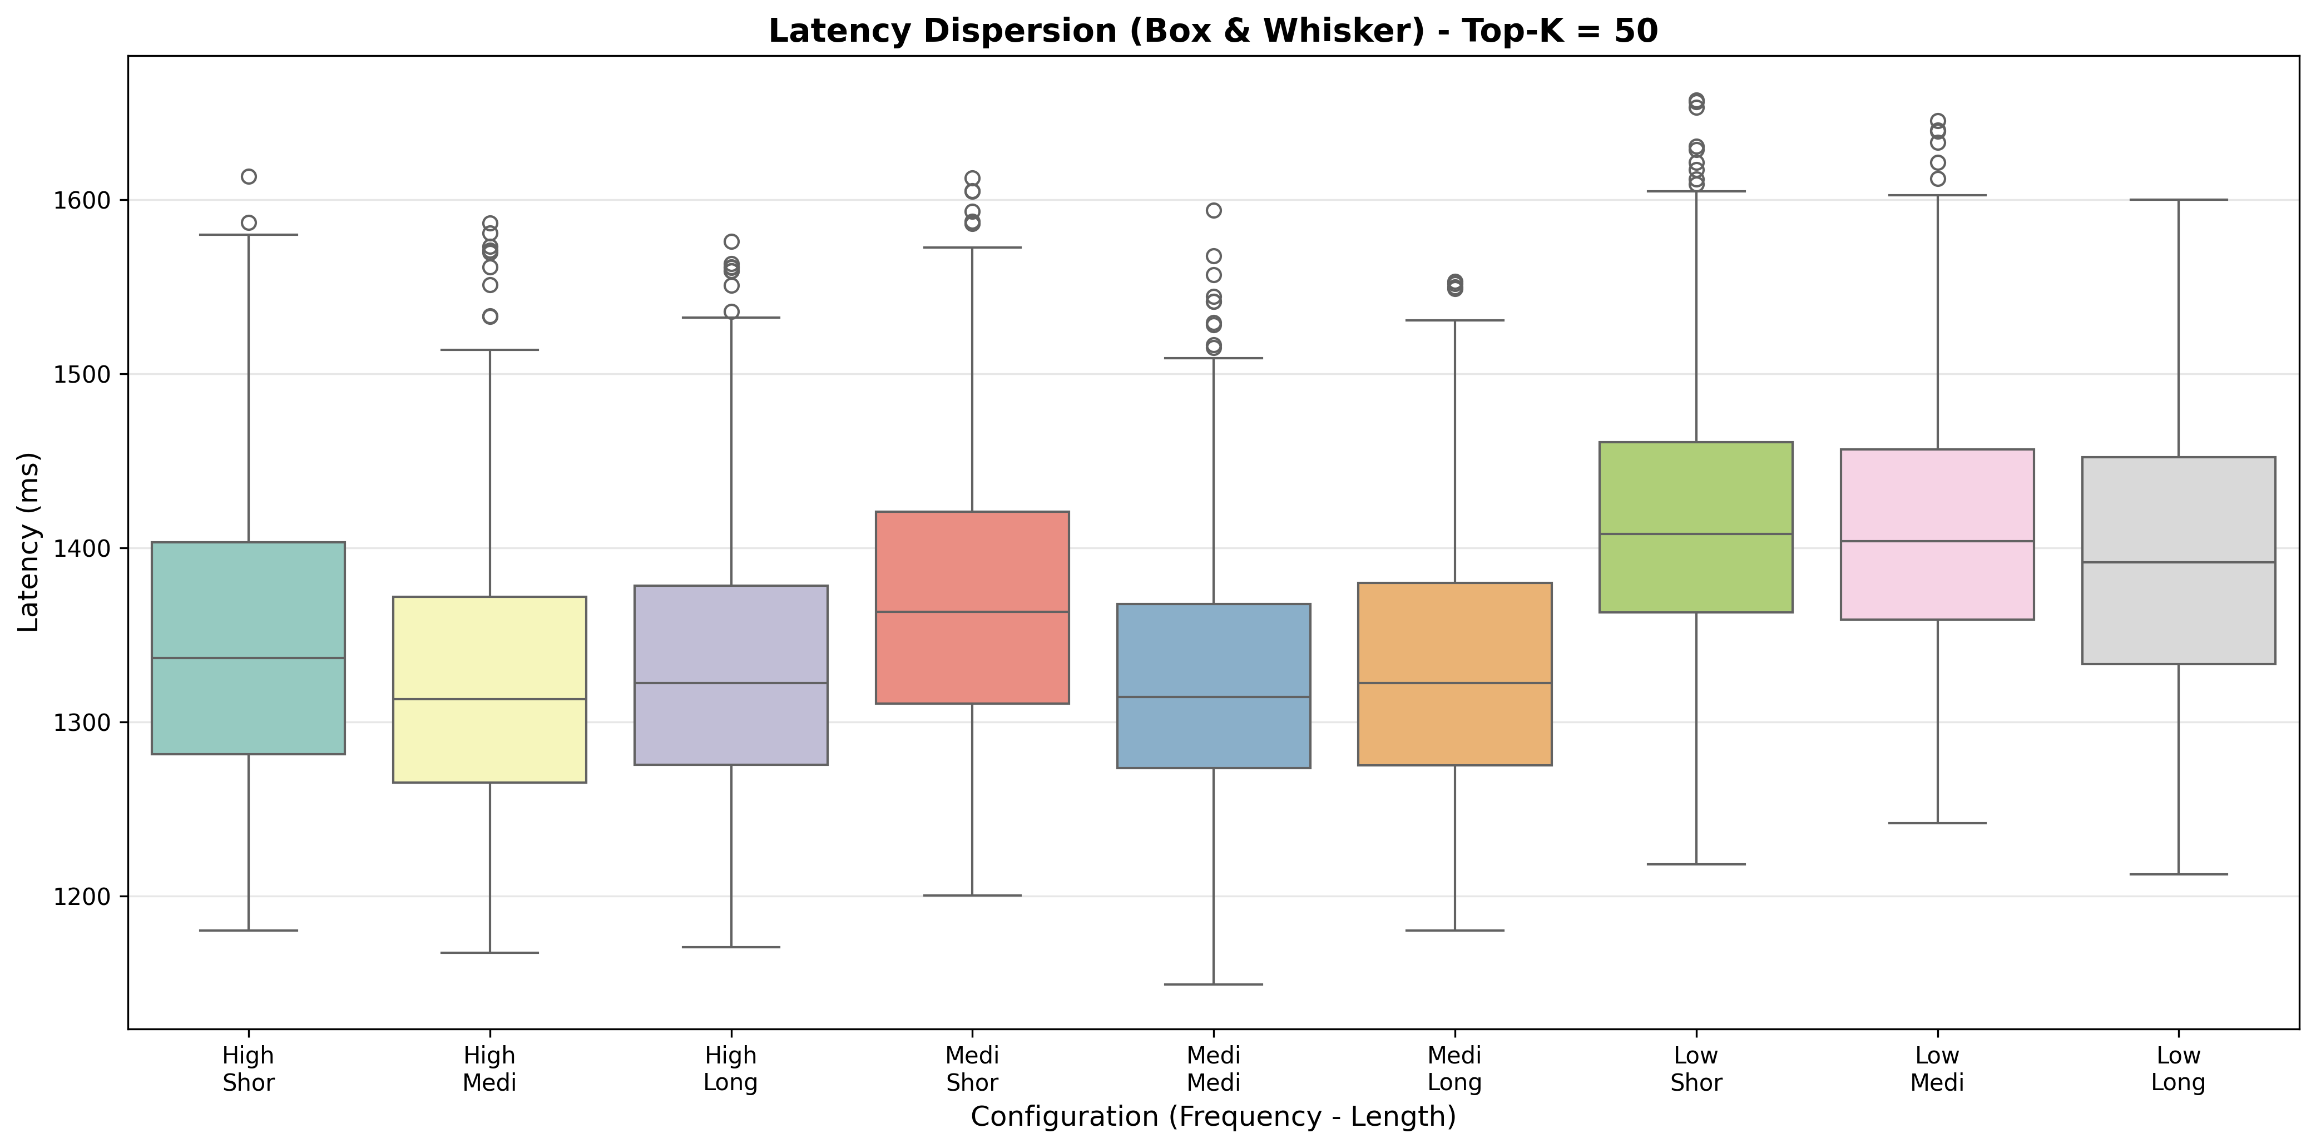
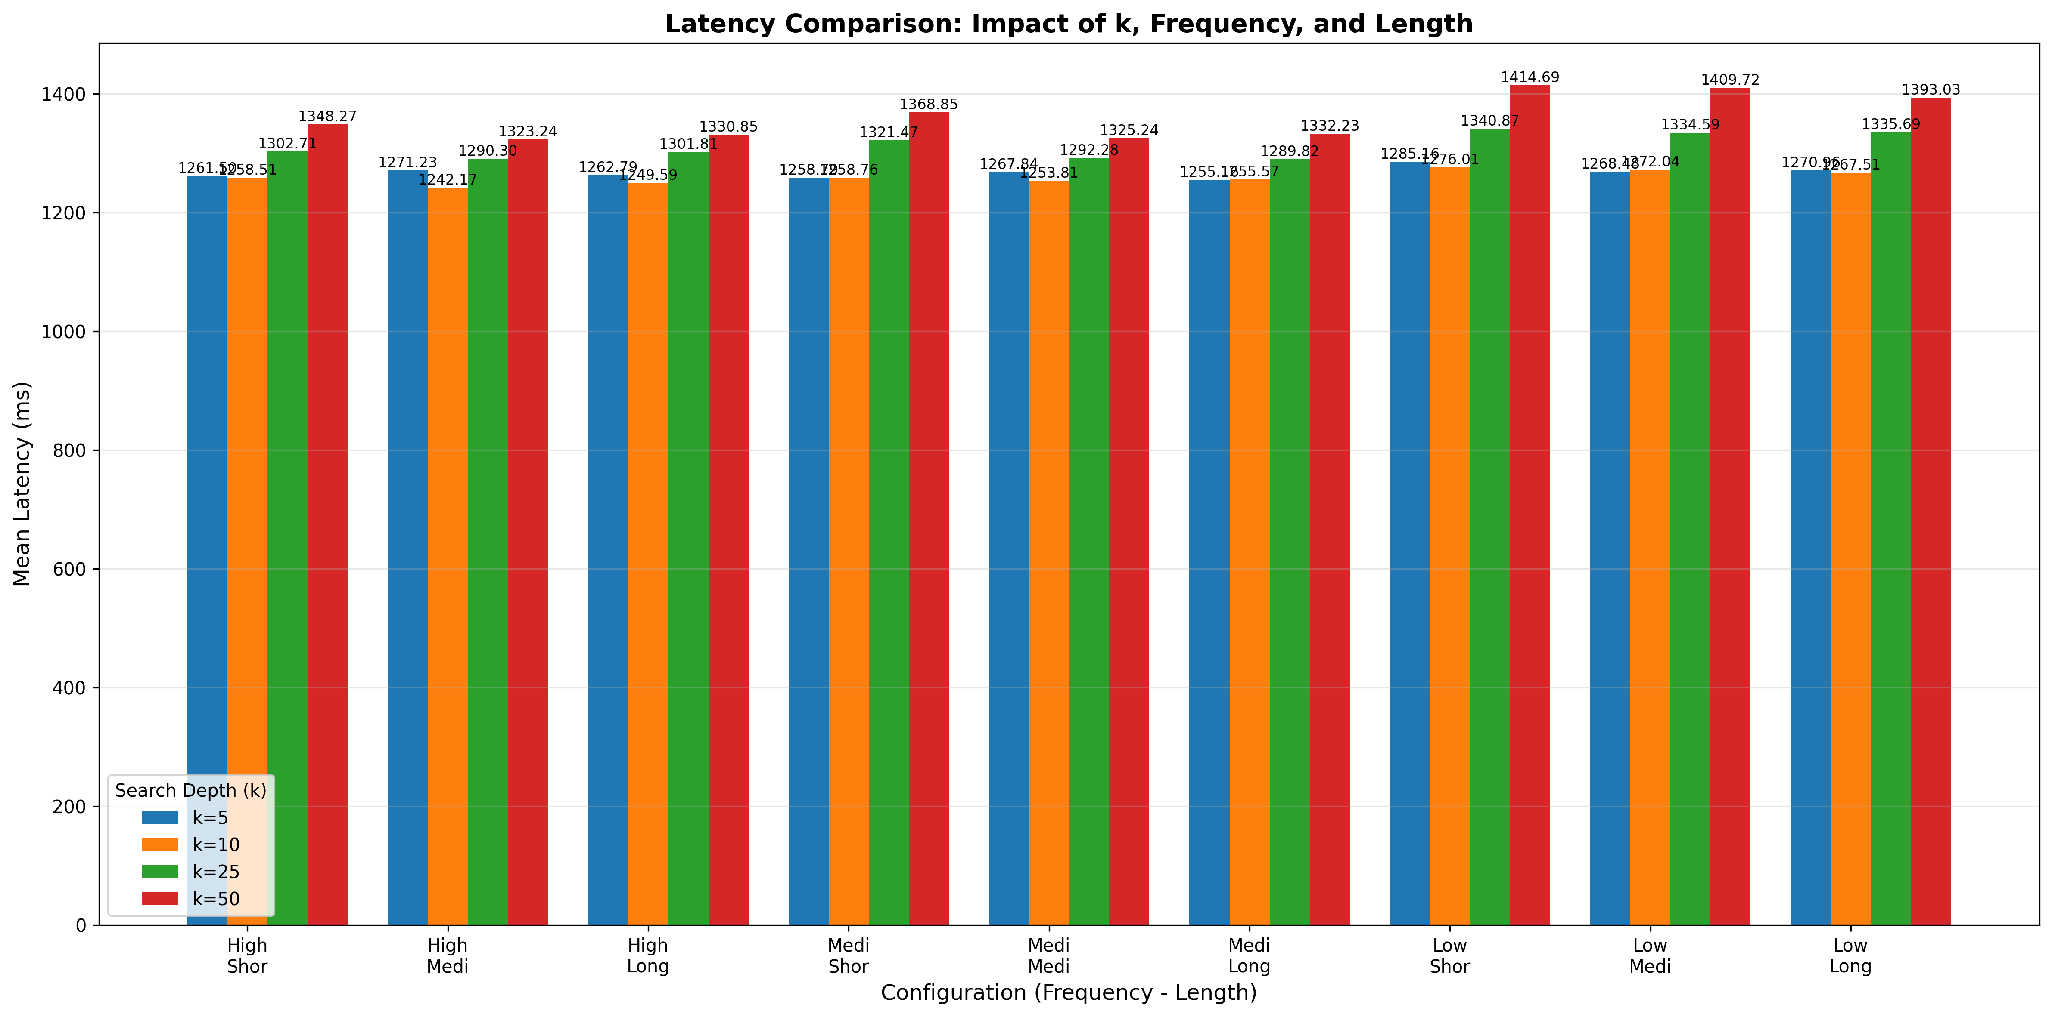
Small Language Model: SmolLM2-135M
Using smaller models significantly reduces computational overhead, clearly revealing timing differences that perfectly mirror the latency patterns observed when querying the database directly.

Slide 7


Next Steps: The Turn Inference Tool
The Mechanism
The Objective
Target Input: The tool receives a specific target word chosen by the user/attacker.
Automated Execution: It automatically generates and sends multiple query rounds containing this specific word to the RAG system.
Timing Measurement: It records the exact microsecond latency of the retrieval phase for every single query executed.
Statistical Analysis: The tool compares the collected timing data against established latency thresholds.
Frequency Inference: It successfully determines the frequency category (High, Medium, Low) of the target word within the hidden database.
The Goal: To calculate the exact number of attempts (turns) required to achieve statistical certainty about the word's presence and frequency.

